Slide 1
GradientBoost Algorithm
Gradient boosting is a method standing out for its prediction speed and accuracy, particularly with large and complex datasets.
Gradient boosting is a machine learning technique used in regression and classification tasks, among others.
It gives a prediction model in the form of an ensemble of weak prediction models.
i.e., models that make very few assumptions about the data, which are typically simple decision trees

Slide 2
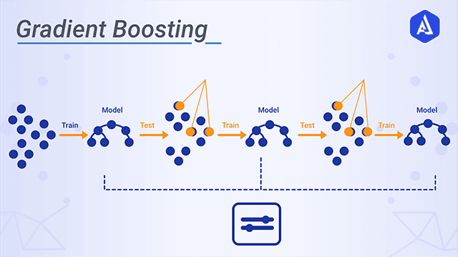
GradientBoost Algorithm

Slide 3
GradientBoost Algorithm
Loss =‘squared_error’, ‘absolute_error’, ‘huber’, ‘quantile’, default=’squared_error’
Learning_rate
N_estimators
Criterion
Min_sample_split
Max_depth

Slide 4
GradientBoost Algorithm
A loss function to be optimized.
A weak learner to make predictions.
An additive model to add weak

Slide 5
GradientBoost Algorithm
Improvements to Basic Gradient Boosting
Tree Constraints
Shrinkage
Random sampling
Penalized Learning

